Slide 1

Module 3.A
IEC Language : SFC

Slide 2
IEC Language SFC
Notes:
This page intentionally blank

Slide 3
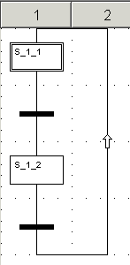
What is SFC ?
SFC : Sequential Function Chart
Graphic method of representing a sequential control system by using a sequence of steps and transitions
Each step is a command or action that is either active or inactive
The flow of control passes from one step to the next through a conditional transition that is either true or false
Standard IEC 1131-3

Slide 4
SFC rules
Sequential program is composed of :
  SFC sections (top level)
  Action sections
  Transition sections
SFC sections are only allowed in the MAST task
Each SFC section contains one or several SFC graphs
A SFC section has 200 rows and 32 columns
A SFC section can contain 1024 steps

Slide 5


Steps
A SFC section is a "state machine"; the state being define by the active steps (100 steps maximum in multiple token)
Normal step
  Becomes active when the prior transition is true
  Becomes inactive when the succeeding transition is true
  Each step contains none, one or several actions
Initial step
  Starts the sequence when the application is initialized
  Don't contain action
  One initial step must be defined in each sequential chain (graph)
Qualifier can be declared for each step
A supervision and a delay times can be defined for each step

Slide 6



Macro step
Macro step
  Use to call the macro step sections
  The macro step sections must be activated in the Tools Project Settings
Input step
  First step of a macro step section
  The input step is automatically created
  Cannot be deleted or inserted
Output step
  Last step of a macro step section
  The output step is automatically created
  Cannot be deleted or inserted

Slide 7


Transition
For each transition the condition can be :
  A boolean variable
  A transition section
    Transition condition is edited using the LD, FBD, ST or IL language
    The result of the evaluation of the transition condition is assigned to a boolean variable with the same name as the transition itself

Slide 8

Jump
To represent a direct link which is not drawn in its full length
Can be placed in all places in a chart but after a transition
Several jumps are possible to the same target

Slide 9
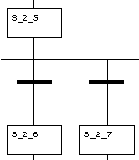
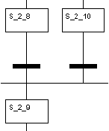
Alternative branch / joint
Alternative branch (OR divergence)
  The branch to execute is determined by the result of each transition condition following the alternative branch
  The branch transition conditions are processed from left to right
Alternative joint (OR convergence)
  The different sequences are joined again into one branch where processing continues
  Normally one step is allowed after an alternative joint
  A parallel branch is also allowed after an alternative joint

Slide 10
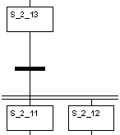
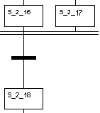
Parallel branch / joint
Parallel branch / joint
  Processing is split up into several sequences (32 maximum)
  The parallel sequences are processed independently from left to right
  Normally one transition is allowed above a parallel branch
  An alternative joint is also allowed above a parallel branch
Parallel joint (AND convergence)
  Combine the parallel sequences to one branch
  The transition following a parallel joint is evaluated when all the predecessor steps have been set (synchronization of the parallel sequences)
  Normally one transition is allowed after a parallel branch
  An alternative branch is also allowed after a parallel joint

Slide 11
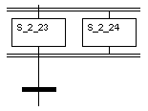
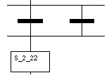
Sequences
To minimize the object creation structure sequences are proposed
  Simple sequence
    Beginning with a step / with a transition
  Parallel sequence with step(s) containing
    AND divergence
    Branches
    AND convergence
    Final transition
  Selection sequence with transition(s) containing
    OR divergence
    Branches
    OR convergence
    Final step

Slide 12
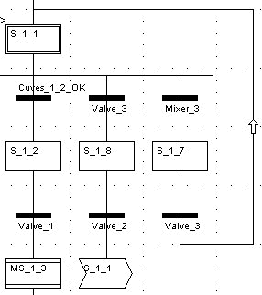
Links
Direct link connects a step to a transition or a transition to a step
Link exists only if the source and destination already exist
Link never connects step to step or transition to transition
Link never overlaps another object (step, transition, jump)
Links can overlap or cross each other
A link is composed of orthogonal segments
An arrow indicated that the link is from botton to top

Slide 13
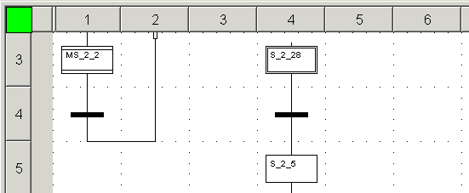
SFC Editor
Freeform editor based on Window Multiple Document Interfaces
Opening a chart section or a macro expansion section launch the editor
A cell can contain every type of objects (the lines are not dedicated for step or transition)
A section has 200 rows and 32 columns

Slide 14
Objects of a SFC program
Step
Macro step
Transition
Jump
Alternative branch / Alternative joint (OR divergence / convergence)
Parallel branch / parallel joint (AND divergence / convergence)
Link
Comment
Simple sequence beginning with step / transition
Parallel sequence / selection sequence

Slide 15
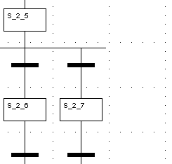
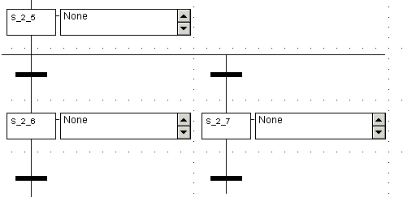
Normal / expanded view
Normal view
Expanded view
Expanded view of the section displays the action list of the steps
Zooms can be applied to the editor

Slide 16
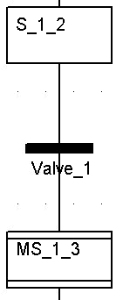
Steps naming
The steps naming is IEC like
  The step name is automatically generated and can be edited (free name)
  A step name must be unique throughout the entire project
  Step name length is 32 characters maximum
  Automatically generated step name has the following structure : S_n_m (for step) or MS_n_m (for macro step)
    S = Step or MS = Macro Step
    n = number of section (consecutive number)
    m = number of step in the section (consecutive number)

Slide 17
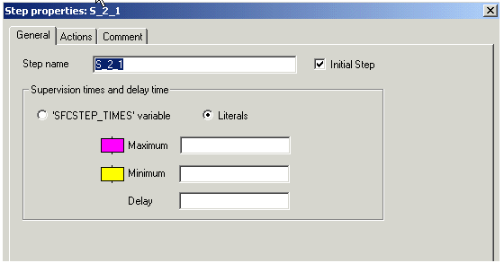
Step properties
3 pages to define the step properties
  Step name
  Initial step attribute
  Supervision times and delay time
    Literal form (ie 10 ms)
    SFCSTEP_TIMES variable
Actions
  Qualifier
  Action time
  Action type (variable, direct address, section)
Comment

Slide 18


Step times
Delay time < Minimum Supervision Time < Maximum Supervision Time
Maximum Supervision Time
  Maximum time for which the step should be active
  If step is active after this time :
    Error message
    The step is colored in magenta (animation mode)
Minimum Supervision Time
  Minimum time for which the step should be active
  If step becomes inactive before this time :
    Error message
    The step is colored in yellow (animation mode)
Delay time (step dwell time)
  Minimum time for which the step must be active

Slide 19
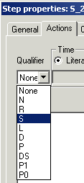
Qualifiers
Define the control for the action linked to a step
  None / N : action is set (1) when the step is active
  R (Reset) : action is reset (0) when the step is active
  S (Set) : action is set and remains at 1 even if the step becomes inactive
  L (time Limited) : action is set during active period of the step
  D (Delayed) : action will be set after a time duration and remains at 1 during active period of the step
  P (Pulse) : the action is set when the step is active and remains at 1 for one program cycle
  DS (Delayed and Set) : action is set after a time duration and remains at 1 even if the step becomes inactive. If the step becomes inactive before the time has elapsed the action is not set

Slide 20
Qualifiers (cont)
Define the control for the action linked to a step
  P1 (Plus, positive edge) : the action is set for one program cycle when the step is active (0 -> 1 edge)
  P0 (Plus, negative edge) : the action is set for one program cycle when the step is active (1 -> 0 edge)

Slide 21
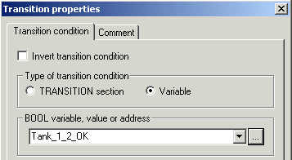
Transition properties
Bool variable (ie Valve_1)
Bool value (0 or 1)
Bool address (%M, %I, ...)
2 pages to define the transition properties
  Invert transition condition (active at 0)
  Type of transition condition (transition section or variable)
  Comment

Slide 22
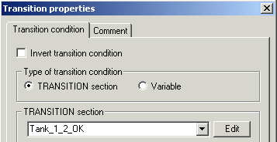
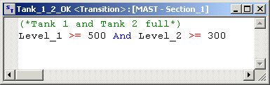
Transition section
  In IL and ST, it contains a logic expression of which the result is automatically assigned to the transition variable (ie. memory assignment ST not allowed in IL, assignment instruction := not allowed in ST)

Slide 23
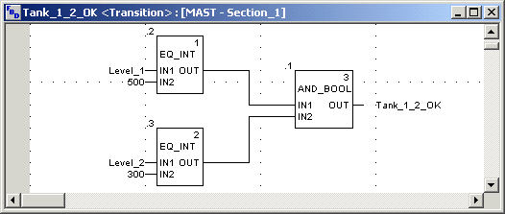
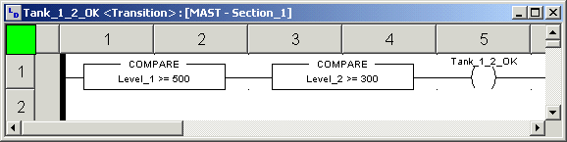
Transition section (cont)
  In FBD, it contains a AND block with output linked to transition variable
  In LD, it contains a network with a coil linked to transition variable

Slide 24
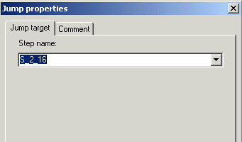
Jump properties
2 pages to define the jump properties
  Jump target (step or macro step name)
  Comment

Slide 25

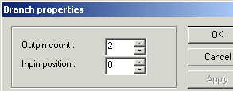
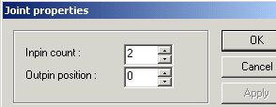
Branch / joint properties
"Handles" to adjust the size to the desired length
Branch properties dialog box
  Number of output pins (size of the object)
  Position of the input pin
Joint properties dialog box
  Number of input pins (size of the object)
  Position of the output pin

Slide 26


Colors of SFC objects
The colors are use when the section is animated
  Step
    Green : step is active
    White : step is inactive
    Yellow : step time is smaller than the minimum supervision time
    Magenta : step time is greater than the maximum supervision time
  Macro step
    Green (upper part) : macro step becomes active
    Green (upper and lower parts) : OUT step of the macro is active
    White : macro step time is inactive
    yellow : macro step time is smaller than the minimum supervision time
    Magenta : macro step time is greater than the maximum supervision time

Slide 27


Colors of SFC objects (cont)
The colors are use when the section is animated
Transition linked to a boolean variable or a simple boolean expression
  Green : boolean variable or expression is TRUE
  Red : boolean variable or expression is FALSE
Transition linked to a section
  Black : prior step is inactive
  Green : conditions of the section are TRUE
  Red : conditions of the section are FALSE

Slide 28
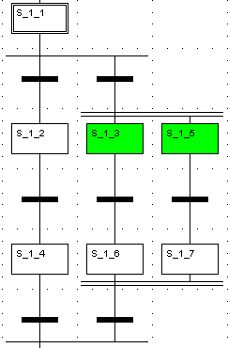
Single-token execution
(1)
Only one initial step (1)
One step is active except in parallel branches (one step per branch) (2)
A transition is evaluated if the previous step is active (3)
Branch transitions are processed from left to right
Only one branch is active in alternative branches (4)
With parallel branches a transition activates several steps (32 max) (5)
Jumps into or out of a parallel branch are not possible
(4)
(5)
(2)
(3)

Slide 29
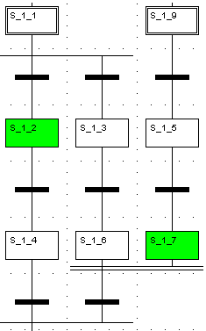
Multiple-token execution
1
Several initial steps (0 to 100) (1)
A macro step can contains initial steps
Several steps are active at same time (2)
A transition is evaluated if the previous step is active (3)
More than one branch can be active in alternative branches
With parallel branches a transition activates several steps
Jumps into or out of a parallel branch are possible
Steps are activated from a non-SFC section (SETSTEP block)
2
3
2

Slide 30
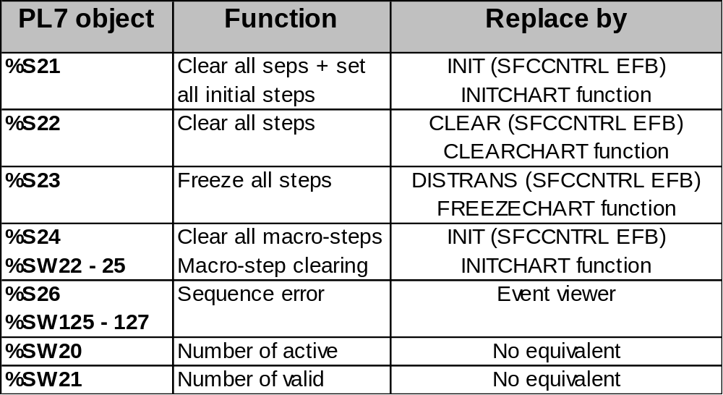
Chart system objects
The system objects to manage the chart are replaced by EF / EFB

Slide 31
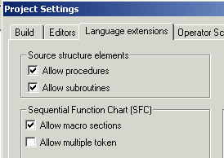
New features from Grafcet
Several SFC sections are possible
PRL/GRAPH/POST sequence does not exist. PRL and POST are replaced by non-SFC sections
Multiple token (several steps active at same time)
Initial step inside a macro section
Setting and resetting of steps is possible in all sections (except SFC action and subroutine sections) (only in PRL with Grafcet)

Slide 32
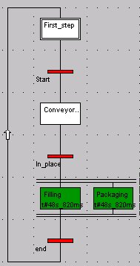
Online Modifications
Full modifications in online mode
SFC section can be created in online mode
SFC steps can be :
  Added
  Modified the properties and actions
  Deleted
SFC transitions can be :
  Added
  Modified the type and expression
  Deleted

